Slide 1

Linking Desires with Destinations
CS_5363_001 – Project Team 4
Akash Machra
Anjikya Tiwari
Bhavya Batra
Manohar Kotapati
Roshan Shetty
Vinay Deshpande
Presentation Date
06 October 2015

Slide 2
Isn’t it Awesome ?
Finest combination of 7 necessities.
Because “Space” matters.
“Best of the breed” experience.
Logical navigation.

Slide 3
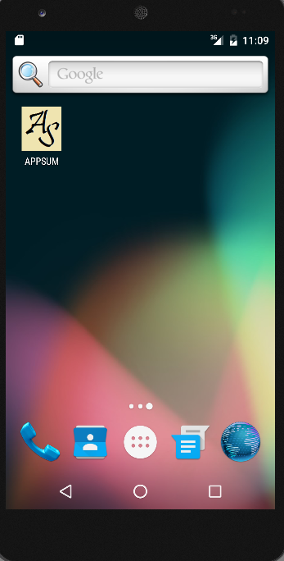
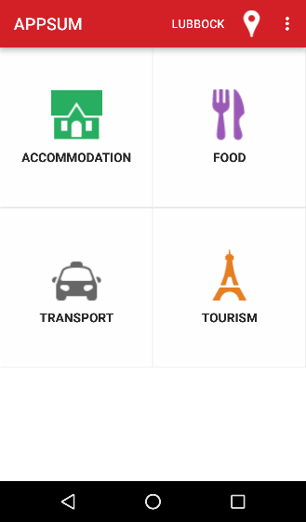
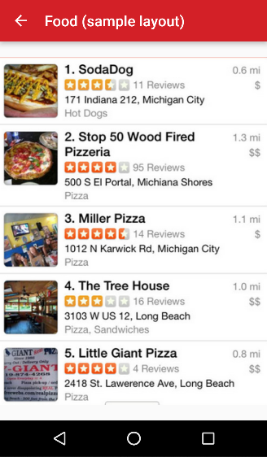
The Design

Slide 4




APIS
Name of the API | Type of the API
Zomato API | Food / Dining
Uber Cabs API | Travel
Trip Advisor API | Tourism
Hotels.com API | Accommodation

Slide 5
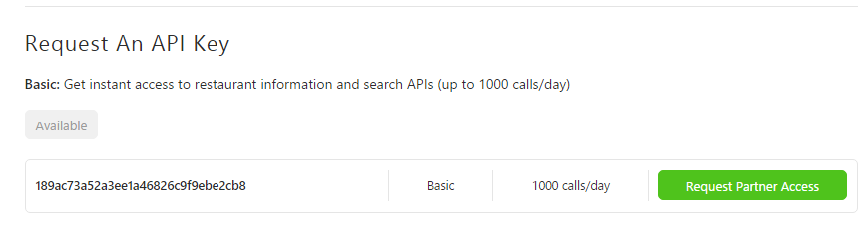
An INSTANCE
Zomato API Key

Slide 6
REQUIREMENTS
Operational and Market Feasibility
  Food, Accommodation, Entertainment, Emergency, Travel, Tourism, Education
  Consolidated All-Purpose Application
Technical Feasibility
  S/W Resources : Android Studio, Java, Operating systems, Pre-Requisites
  H/W resources
  Technical Personnel
  System Requirements (Iteration 2 Specific) :- Location Finder, Home Screens

Slide 7

Iteration 1

Slide 8
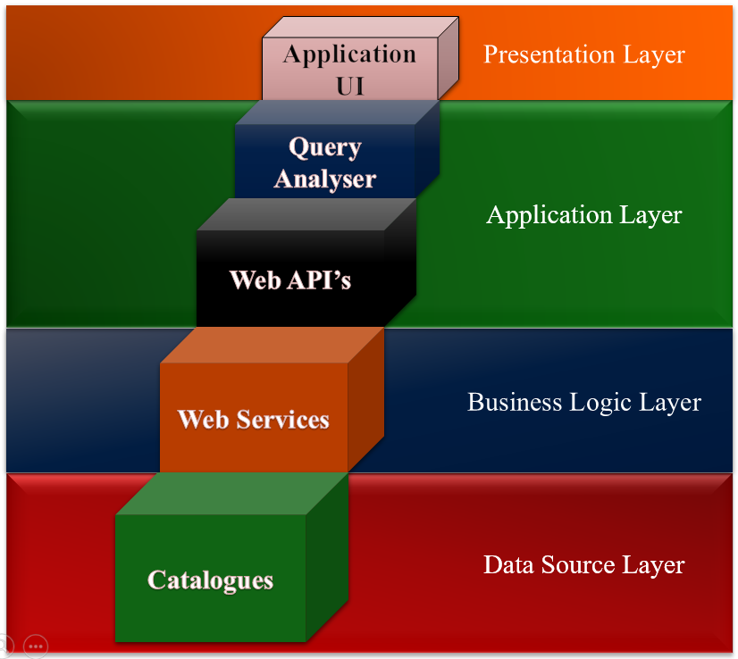
Architecture

Slide 9

Iteration 2

Slide 10
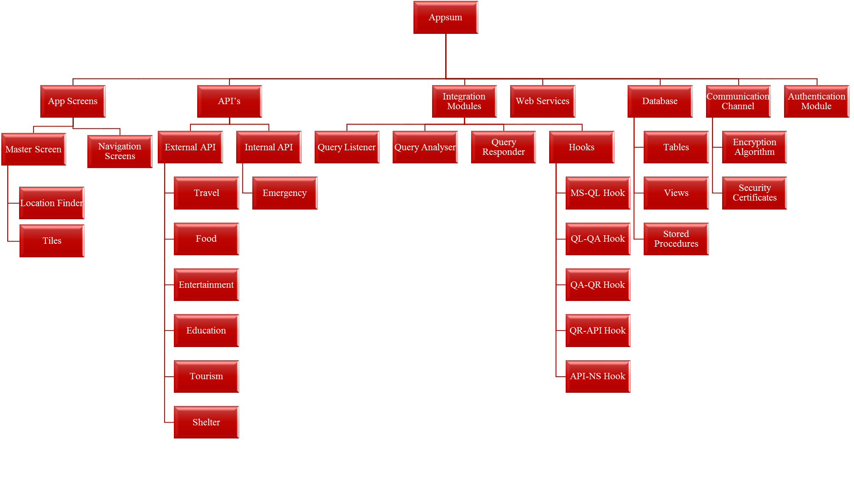
ADV

Slide 11

Iteration 2

Slide 12
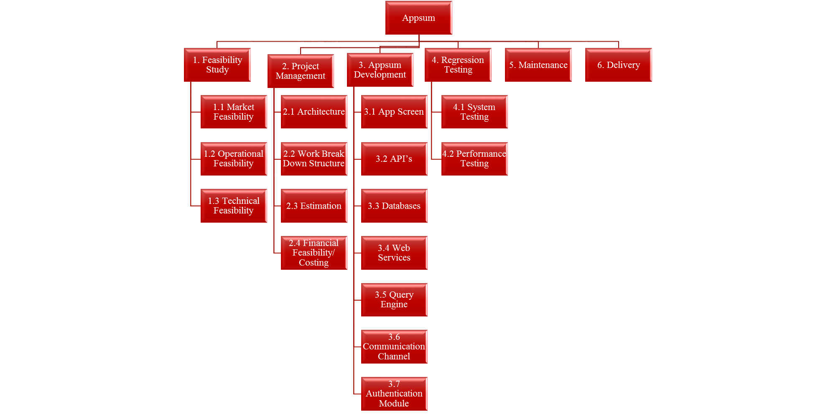
WBS-I

Slide 13
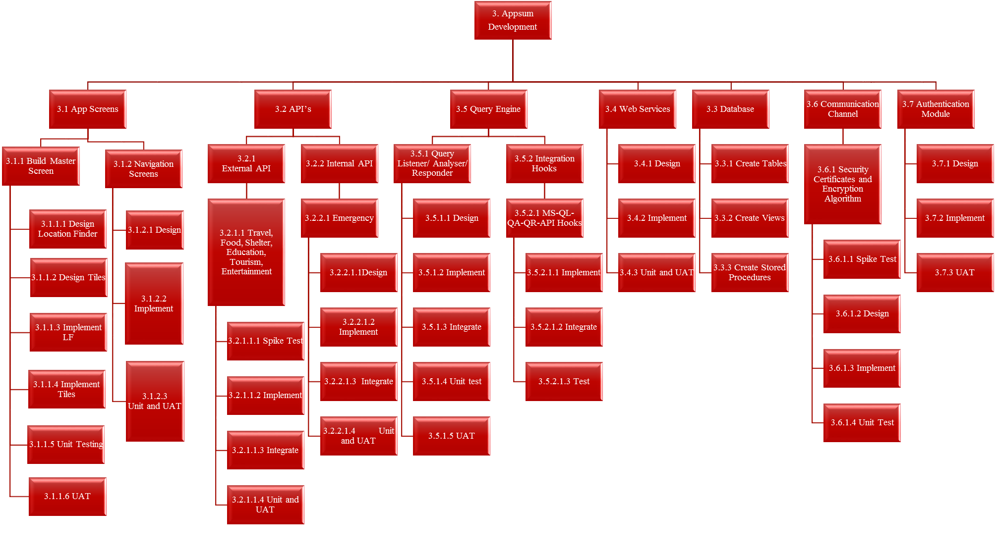
WBS-II

Slide 14
Risks - Beware
Insecure Development Practices.
Security Breaches and Attacks.
Hardware Crash.
Software Crash.
API Risks.
Malicious Code Injection
Business Logic Attacks
Identity and Session Threat
Service Information Leakage

Slide 15
Dealing with Risks
Identify Vulnerabilities an API already has.
Monitor, Audit, Log and Analyze API Traffic.
Encrypt the Message Channels.

Slide 16
Schedule – Iteration 2
  Duration - 3 weeks
  Training
  Investigation on external APIs
  Prototype

Slide 17
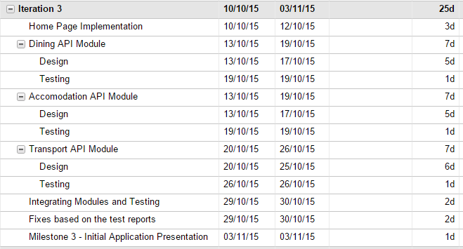
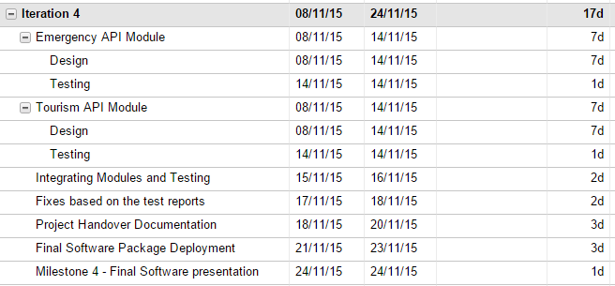
And ROSTER

Slide 18
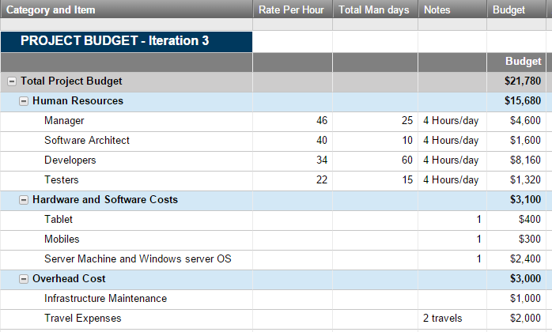
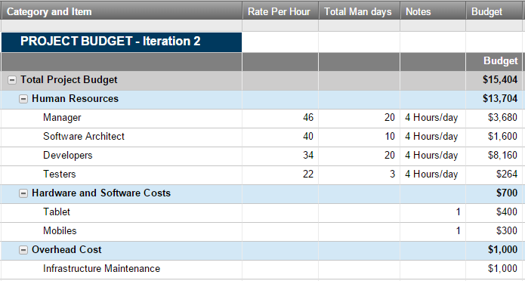
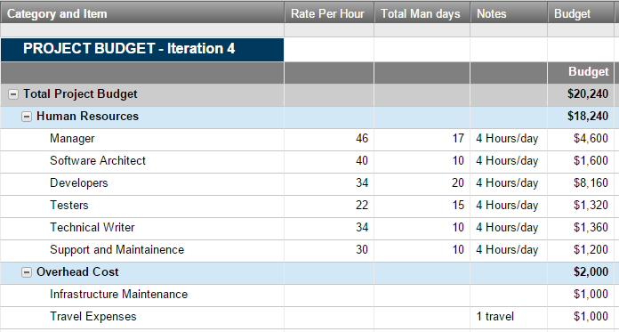
BECAUSE $ STILL MATTERS

Slide 19
WORKOUT
Team Members | Android Training | Java Training | Screens | ADV | WBS | Budget | Requirements | API | Risk Mgmt | Schedule
Anjikya Tiwari | ✓ | ✓ | ✓
Akash Machra | ✓ | ✓ |  |  |  | ✓ | ✓
Bhavya Batra | ✓ | ✓ |  | ✓ | ✓
Manohar | ✓ | ✓ | ✓ |  |  | ✓ |  |  |  | ✓
Roshan | ✓ | ✓ | ✓ |  |  |  |  |  | ✓
Vinay | ✓ | ✓ |  |  |  |  |  | ✓

Slide 20
Software Demo – Iteration 2
  Things we did…
  Launcher Icon
  Designed home page layout with menu items
  Space on Action bar for current city indication and location icon to change the city
  Functionality of auto detecting current city and changing city not yet implemented. To show the expected layout, current city is hardcoded as Lubbock
  Select the Food menu item for expected sample layout that we are going to design in coming iteration
  Test cases for this iteration
  Application launch with APPSUM icon
  Home page with 4 menu items
  Title display on selection of each menu item
  Sample layout image on selecting Food menu item
  Check field on action bar for current city (Auto detecting not yet implemented)
  Location icon to change the city ( Functionality not yet implemented)

